Slide 1
Sprint 3 Review
Group 4: Pottenger, Langford, Dely McShane, Snider

Slide 2
User Stories
SF-13 – As a player, I want to select a single tile from the game board and remove all tiles with the same number. Can only be done once.
SF-14 – As a player, I want to know where I can place my selected tile to remove the most tiles from the game board. Can be done up to three times.
SF-16 – Added the date column to our Top Ten Most Points list
SF-17 – As a player, I want to add my name to the “Top Ten Least Time” list whenever I qualify.
SF-22 – As a player, I want gameplay to be engaging.

Slide 3
Burndown Chart

Slide 4
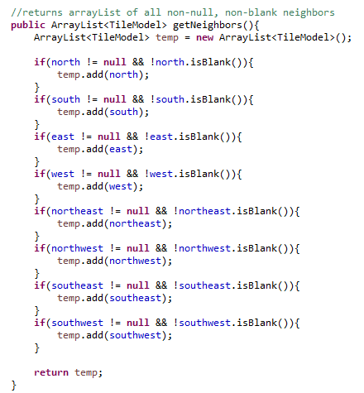
Blackbox Testing
Equivalence Classes:
For each neighbor:
TileModel north : {null, not null}
Boolean north.isBlank() : {T, F}
Outputs:
Array length : {0-8}
Test Cases:
1) All null
2) All blank
3) All non-null and non-blank

Slide 5
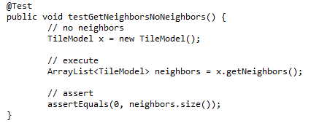
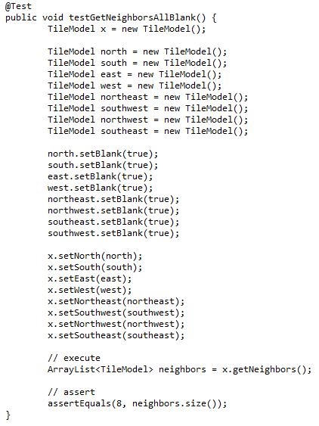
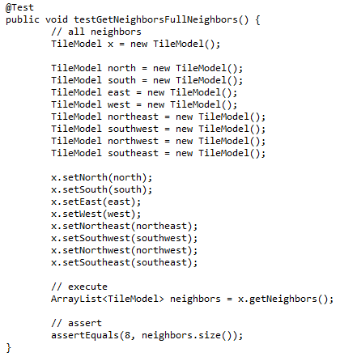
Blackbox Testing

Slide 6
Whitebox Testing
north
!null and
!blank
null
blank
Add to array
south

Slide 7
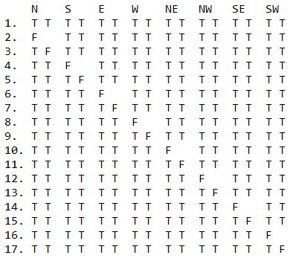
Whitebox Testing
8 conditional statements, each checking two conditions => need 8*2 + 1 = 17 test cases

Slide 8
